Slide 1
Warm-Up
Who is your enlightenment thinker?
What is their contribution/new idea?

Slide 2
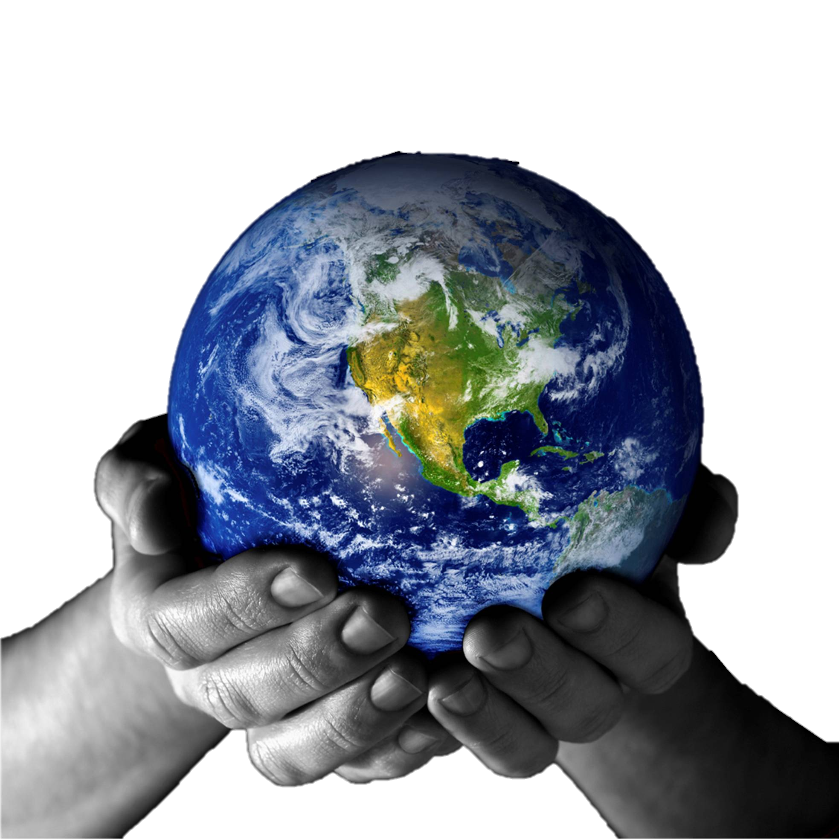
Political Geography

Slide 3
Warm-Up (answer on the back of the reading)
1. Why is it difficult to determine how many countries exist?
2. What are requirements for statehood?
3. What is a de facto state? What are benefits of being a de facto state?
Who decides what states America will recognize? Is this a good system? Why or why not?

Slide 4
Political Geography
Study of the organization and distribution of political phenomena, including their impact on other spatial components of society and culture
Characteristics of political entities, problems in defining jurisdictions, and significance of fragmentation of political power

Slide 5
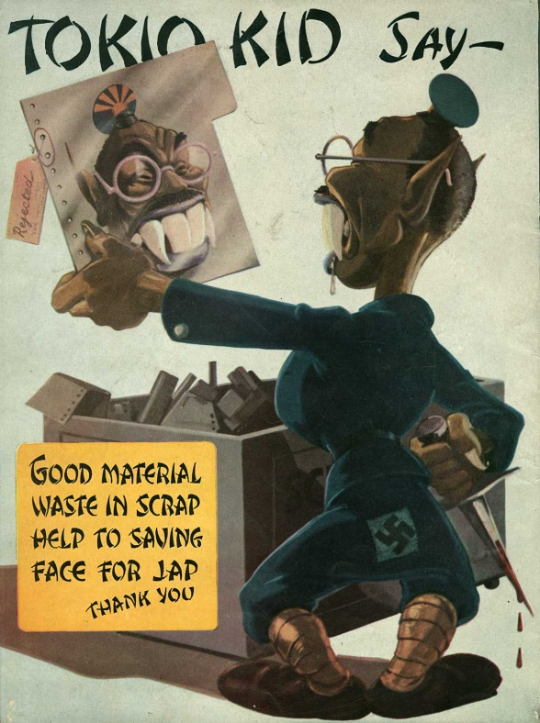
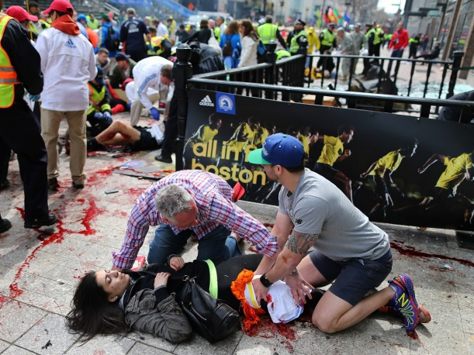
Political Geography
Explains physical and cultural factors that underline political unrest
20th century conflict was between states; 21st century conflicted initiated by individuals or groups

Slide 6
Definition of a State

Slide 7
Territoriality is creating ownership over a defined space.
Also applies to personal space (the area we claim as our own territory which others may not enter without our permission). How much space is considered personal can vary with time and place
Notes:
Can apply to your bedroom or an entire country and often evoke an emotional response.
Also applies to personal space (the area we claim as our own territory which others may not enter without our permission). How much space is considered personal can very with time and place.

Slide 8
The State (political)

Slide 9
State
Effective Government and Economy
Permanent Population
Sovereignty
Recognized by other States
Notes:
State = country
The Earth is divided among approximately 200 states, in the past 100 years the number of states have increased by over 100.

Slide 10
Sovereignty means that a state is independent from control of its internal affairs by other states.
Once a state has sovereignty then it can determine its own tax structure, laws, and political structure.
Cannot obtain sovereignty simply by declaring it. Once foreign countries begin to recognize the country and treat it like a state, then it becomes a state.
Notes:
Technically Native Americans possess their own sovereignty when on reservations.

Slide 11
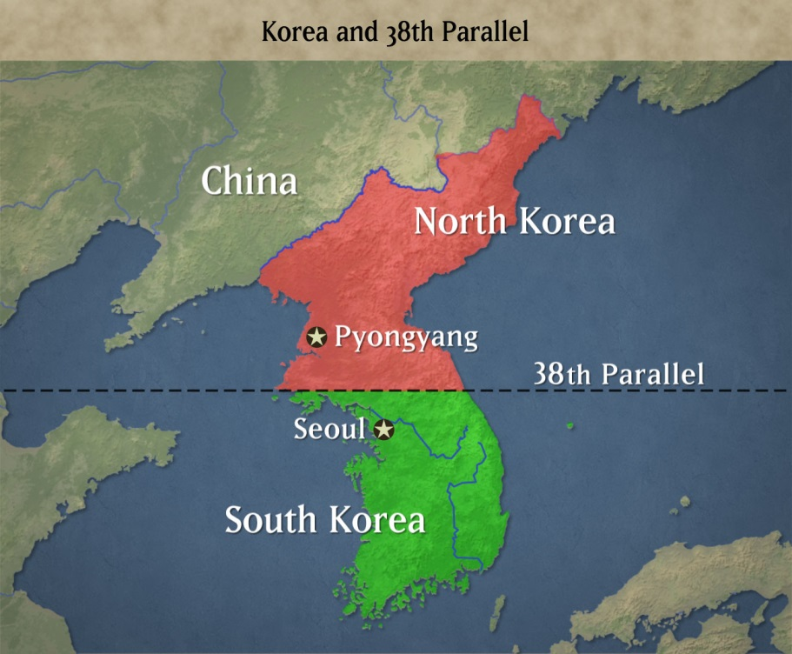
Defining States
State = Country
State DOES NOT = Louisiana, Texas, California, etc.
Whether or not an area of land is a state can be complicated….
Korea, Taiwan, the Poles

Slide 12
Types of States
Buffer State: Mongolia between Russia and China
Satellite States: Poland was a satellite of Russia
Shatterbelts: Eastern Europe between the USSR and Western Europe
Notes:
Buffer States = state located between two larger states that are in conflict
Buffer Zone = eastern Europe between Soviet Union and Western Europe
Satellites = states controlled by another, more powerful state
Shatterbelts = states that exist within a sphere of competition between larger states

Slide 13
The Nation

Slide 14
Language, religion, a shared history, and territory are cultural elements that can create such cohesion and form a nation
Nation
Culturally Defined
Shared Culture
Not defined by territory
“An Imagined Community”
Conflict occurring between different nations is referred to as ethnonational conflict.
Notes:
Language, religion, a shared history, and territory are cultural elements that can create such cohesion and form a nation.
Internal differences often exist within a people who consider themselves nations but the sense of belonging can override these differences. Ex- Native Americans have unique traits but feel a sense of belonging to the Native American nation.
People are often willing to fight on behalf of their national identity, even more when they feel they do not have self-determination (power to control their own territory and destiny). Conflict occurring between different nations is referred to as ethnonational conflict.

Slide 15
Different Types of Nations
Multinational State
Ex: Soviet Union
Multistate Nations (Irredentism)
EX: The Roma
Stateless Nations
Ex: Palestine
Nation-State
Ex: Japan
A state with more than one nation inside its borders
A nation that stretches across borders. (Irredentism)
A nation that does not have a state.
A state with 95% or more belonging to one nationality
Notes:
. Nearly every State in the world is a multinational state.
Multistate Nation = A nation that stretches across borders. (Irredentism)
Stateless Nation = A nation that does not have a state.
Nation State = A state with 95% or more belonging to one nationality.
The idea of linking people who share a strong sense of unity under one government seemed to be the best way to prevent ethnonational violence from erupting.

Slide 16
Multinational State
Former Yugoslavia was a Multi-National State

Slide 17
Roma Gypsies

Slide 18
Stateless Nation

Slide 19
Nationless States Activity
You will create a poster about a nation without a state. On this poster you will include:
Information about the nation which makes them distinct and different from surrounding ethnic groups
Conflict of Struggles with other groups
Images: Map of the area they occupy, Picture of the people group

Slide 20
Warm-Up
What is the difference between a Nation, a State, and a Nation- State. Give an example of each.

Slide 21
Shape of States

Slide 22
Territorial Morphology is a term that describes the shape, size, and relative location of states.
Notes:
Factors like shape, size, and relative location can affect the political issues facing its people internally and internationally.

Slide 23
Compact
Elongated
Fragmented
Prorupt
Perforated
Land locked
Exclave
Enclave
Micro-State
Illustration
Definition
2 positives of shape
2 negatives of shape
2 examples

Slide 24
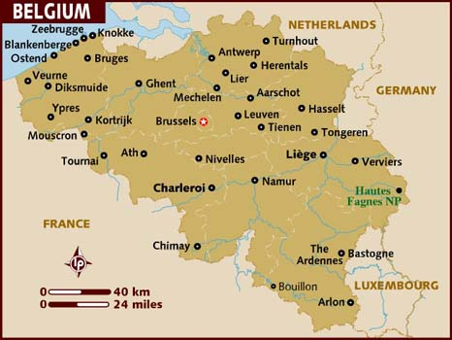
Compact State
The distance from the center to any boundary is about the same.
The political ideal because no one part feels too far away from the center of control.
Easy for defense and communication.
Can be rather small.
Notes:
Can be nearly square or circle in shape.

Slide 25
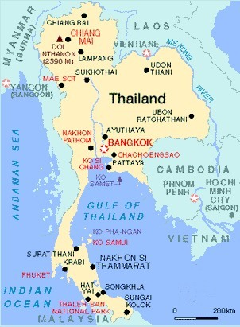
Prorupted State
A large, compact state with a large projecting extension.
The jutting piece may try to break away or could be invaded.
Usually to increase access to resources.
Usually created by colonial powers and can be hard to justify.

Slide 26
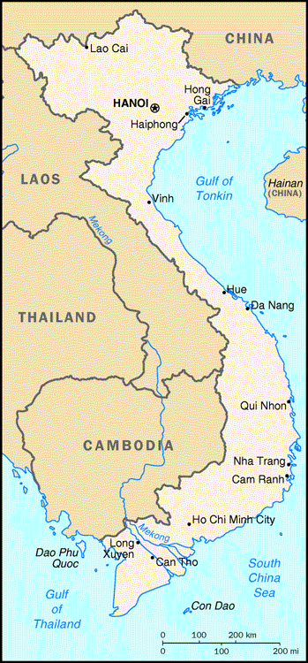
Elongated State
A state that is long and narrow.
Twice as long as they are wide.
Can pose transportation and communication problems.
Problems can also arise when a state’s power base loses influence over one end of the elongation.

Slide 27
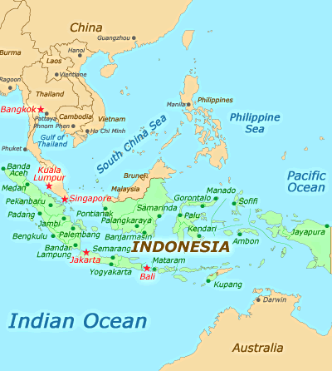
Fragmented State
A state that is separated by a physical or human barrier.
Can lead to problems in maintaining unity among its constituent parts and problems with communication.
Other countries would have a hard time invading your country.
Notes:
Can lead to problems in maintaining unity among its constituent parts and problems with communication.
Other countries would have a hard time invading your country.

Slide 28
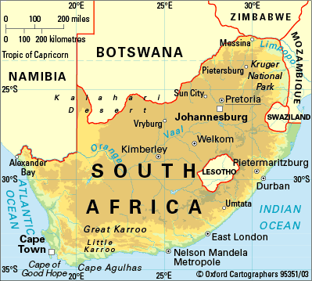
Perforated / Enclave State
A perforated state has a hole punched in it by another state.
An enclave state is completely surrounded by another state.
Notes:
Relationships between the perforated state and its perforating state can be difficult and can cause tension.
Cultural enclaves exist as well.

Slide 29
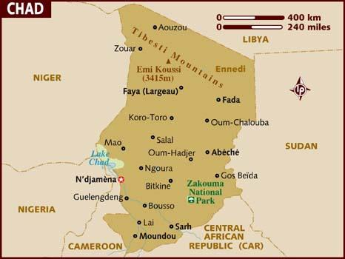
Landlocked State
A state with no access
to a major sea or
ocean.
Must depend on their neighbors to get water sources for trade and navigation so their relationships must always be good.
Tariffs can increase their prices.
Notes:
Must depend on their neighbors to get water sources for trade and navigation so their relationships must always be good.
Tariffs can increase their prices.

Slide 30
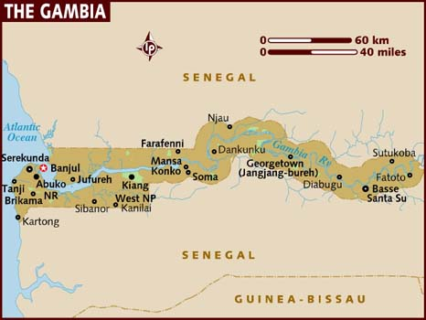
Pene-Enclave
Intrusive piece of territory with a tiny outlet.

Slide 31
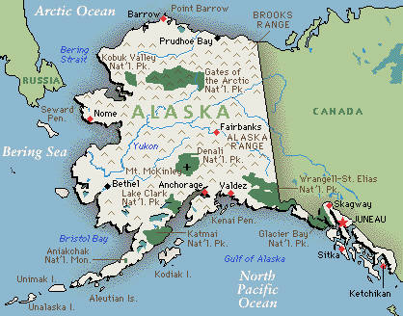
Exclave State
A part of a state almost completely separated from the rest of the country.
Can cause conflict over boundaries.

Slide 32
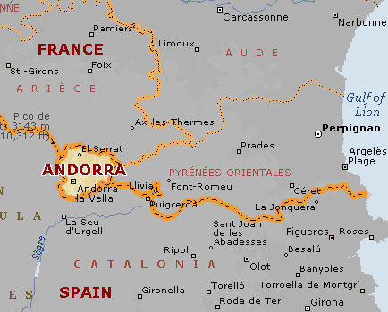
Micro-State
A microstate may only be a few square miles.
Can have a lack of resources but also have less area to defend. Can be small in population and area.
More homogenous population – less conflict.
Small in size does not equal small in power.
Notes:
Can have a lack of resources but also have less area to defend. Can be small in population and area.
More homogenous population – less conflict.
Small in size does not equal small in power.

Slide 33
Boundaries and Borders
Notes:
Root of many conflicts at varying scales

Slide 34
Boundaries are invisible lines that mark the extent of a state’s territory and control its leaders have.
Political boundaries have been fought over for centuries because Governments tend to want more and more space for economic gain or to have greater cultural influence over a region.

Slide 35
Before boundaries, there were frontiers.

Slide 36
A frontier is a geographic zone where no state exercises power. It is a neutral zone of power.
Boundary is a line and frontier is a region.
Notes:
Boundary is a line and frontier is a region.

Slide 37
Types of Boundaries
Geometric
Straight Line that is totally unrelated to any physical or cultural landscape.
Physical
Outline by a physiographic landscape feature
Cultural
Marks breaks in the human landscape such as religion or language
Ex:
Ex:
Ex:
Adv/Dis:
Adv/Dis:
Adv/Dis:
Notes:
Geometric usually use line of latitude or longitude. Has advantages because the lines are easy to determine with GPS.
Physical boundaries have disadvantages because they could move or if you have a building project it involves working with 2 governments.
Cultural lines can be ambiguous and fluid.

Slide 38
How do we get boundaries?
1: Define
Identify the boundary
2: Delimit It
Survey the boundary and draw it on a map
3: Demarcate It
Build an actual marker (fences, wall, flag …)
4: Administration
Impose rules and laws at the boundary
Notes:
Not all boundaries are demarcated.
The actual drawing of a boundary involves representatives of a minimum of two countries that usually meet in a neutral city to discuss terms of the agreement. When the boundary is in dispute, a mediator from another country may be used to assist in determining where it should be located.

Slide 39
Boundary Disputes …
Definitional/Territorial: Arises over the ownership of a region. Ex. Kashmir
Locational/Positional: Occur when states argue about where the border actually is. Ex. Saudi Arabia and Yemen
Allocation: Involves natural resources that lie in the border area. Ex. Iraq and Kuwait
Operational: When neighboring states cannot agree on policies that apply in a border area. Ex. US and Mexico Border

Slide 40
Cultural: The Most Dangerous Border in the World
Example of Irredentism-the nationalist belief that a territory belonging to another country should be annexed for ethnic or historical reasons.
Both Pakistan and India claim the region of Kashmir.
The region is home to both Muslims and Hindus.
Vice: Bad Borders Clip

Slide 41
Hartshorne’s
Evolution of Boundaries
Antecedent
The boundary was set up before a settlement was established.
Subsequent
The boundary was set up after the settlement was established.
Superimposed
The boundary is forcibly put on the landscape by outsiders.
Boundaries that are no longer there, but still exist in a cultural sense.
Relict
Ex:
Ex:
Ex:
Ex:
Notes:
Antecedent – Kentucky and Indiana grew out of distinct cultures that were already present around the divide of the Ohio River.
Subsequent – Division between U.S and Mexico/ changed over time with the rio bravo
Superimposed – Boundary of Israel was superimposed by the United Nations. DMZ in Korea
Relict – Berlin Wall – no longer a boundary but just a reminder of the once divided space.
Go over purposes of each of these barriers and consequences

Slide 43
Superimposed- drawn over existing boundaries Subsequent- Drawn after it is heavily populated

Slide 44
Consequent (ethnographic) – one drawn to accommodate religious, linguistic, ethnic, or economic differences

Slide 45
Boundries with Barriers
Berlin Wall
US Mexico Wall
DMZ- North and South Korea
Green Wall- Israel and Palestine
Problems with Unnatural Physical Barriers
Stop Animal Migrations
Create difficulty trading
Increase tensions between bordering areas

Slide 46
Functions of Boundaries
“Walls”
Limit state jurisdiction
State symbols

Slide 47
Functions of Boundaries
Internal boundaries
For administrative purposes
Examples: United States or Canada

Slide 48
Convention on the Law of the Seas
The United Nations has generally paved out the following guiding provisions:
Coastal States can stake their claim to the sea up to 12 nautical miles from the shoreline.
A coastal state can claim up to 200 nautical miles of territory beyond its shoreline as an exclusive economic zone.
Notes:
How much of a claim can a country make on the water that touches its borders? Been in place since 1982.
If there is not 200 nautical miles between countries the they will divide up the water evenly. (median-line principle) Beyond 200 miles is open for free use by all political states.

Slide 49
Challenges to the State

Slide 50
Centripetal and Centrifugal Forces

Slide 51
Centripetal Forces
Centrifugal Forces
Forces that unify states.
Forces that fragment states.
Notes:
F = Fracture
T = Together

Slide 52
Centripetal Forces
Nationalism
Flags, Symbols, Holidays
Schools and Education
Church and Religion
Transportation
Communication

Slide 53
Centrifugal Forces
Opposing Institutions
Oppositional Nationalism
Separatist Movements
Peripheral Locations
Ethnic Forces
Economic Forces

Slide 54
Geopolitics is the study of how states behave as political and territorial systems.

Slide 55
The Power Structure of Global Politics
Friedrich Ratzel
States are like biological organisms
Sir Halford MacKinder
The Heartland Theory
They want to grow larger and larger through acquiring more nourishment.
Eurasia has the resources to rule the world.
Nicholas Spykmann
The Rimland Theory
The Rimland (Encircles the Heartland of Eurasia) has Control
Organic Theory
Notes:
Organic = Hitler used this a justification for invading other states, lebenstraum
Heartland (1904)= Era of sea power was over and land was the key to dominating the world and key to ruling the world is to control Eastern Europe because it is one of the richest agricultural regions in the world (Cold War and Domino Theory)
Rimland = He thought it was important to balance the power in the rimland to prevent a global power from emerging so he encouraged the forming of alliances to keep the Heartland in check (linked to Vietnam and Korean Wars)

Slide 56
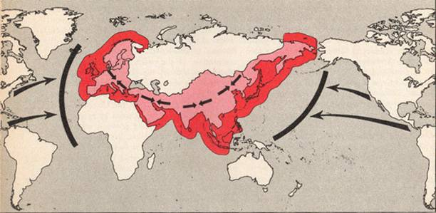
Rimland Theory

Slide 57
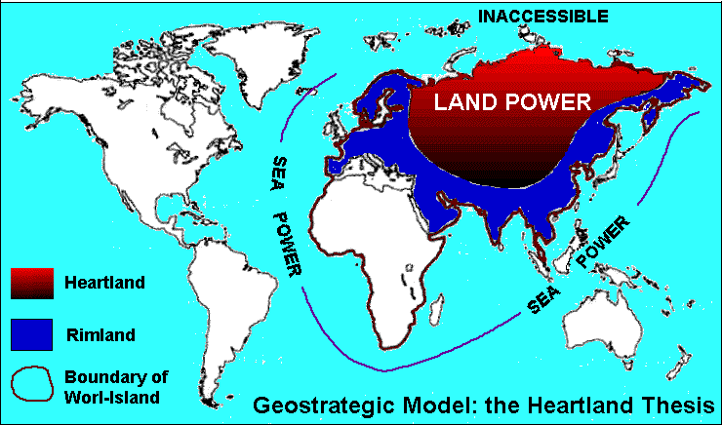
Heartland Theory

Slide 58
What is Terrorism?
The unlawful act of force or violence against individuals or property to coerce or intimidate governments or societies to achieve political, religious or ideological objectives.
~ US State Department

Slide 60
Key Components of Terrorism
The Intentional, rational and targeted use of violence
Intended to cause fear
Attacks are not geared to the specific victim
Attacks are designed to influence a greater audience from that in which the victims reside
Goal is to change behavior in a government or society or bring attention to one’s cause
Rules of international law governing military combat and tactics are not observed

Slide 61
Two trends have developed in terrorist activity (domestic and international)
The overall number is declining
The damage caused by terrorist acts is increasing

Slide 63
Political Organization and Devolution
Notes:
Humans use space in different ways and have different methods of governing that space.

Slide 64
Types of Government in States
Notes:
A state’s size and cultural composition are also factors in its political situation and internal organization.

Slide 65
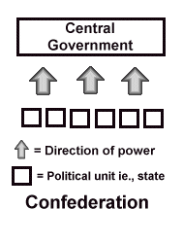
C O N F E D E R A C Y
Regional governments hold the majority of the power.

Slide 66
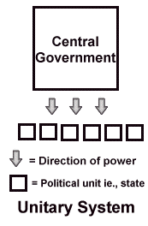
U N I T A R Y
One main governmental decision-making body for the entire state.
(Ex: Dictatorship)
Notes:
Regions within the country may have their own local governments but they are weak and serve only as administrative organs of the unitary government. (often smaller, homogeneous states)

Slide 67
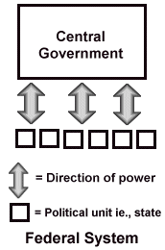
F E D E R A L I S M
Central governments and strong regional governments share power.
Notes:
Ideal for states that are large/diverse and may have regions that want a sense of self-determination.
More and more of a trend toward this style of government.

Slide 68
Devolution is the transfer of power from the central government to regional governments.
Balkanization occurs when forces are so great to break apart the state into smaller, independent pieces.

Slide 69
Ethnic Forces
When a state contains a strong ethnic group that is different than the majority it can cause ethnonationalism.
Economic Forces
When one area of a state is economically
inequal to the other areas.
Spatial Forces
Distance, remoteness, and peripheral location promote devolution, especially if water, desert, or mountains separate the areas from the center of power.

Slide 70
What is Gerrymandering?

Slide 71
Redistricting and the Census
Proportional Representation- Census is taken every 10 years to ensure that districts receive the same representation in House
Allocation of seats- Number of Representatives for state is decided on the population
Redraw Boundaries- make sure you have the right number of people in each district
GIS- is used to determine the best realignments

Slide 72
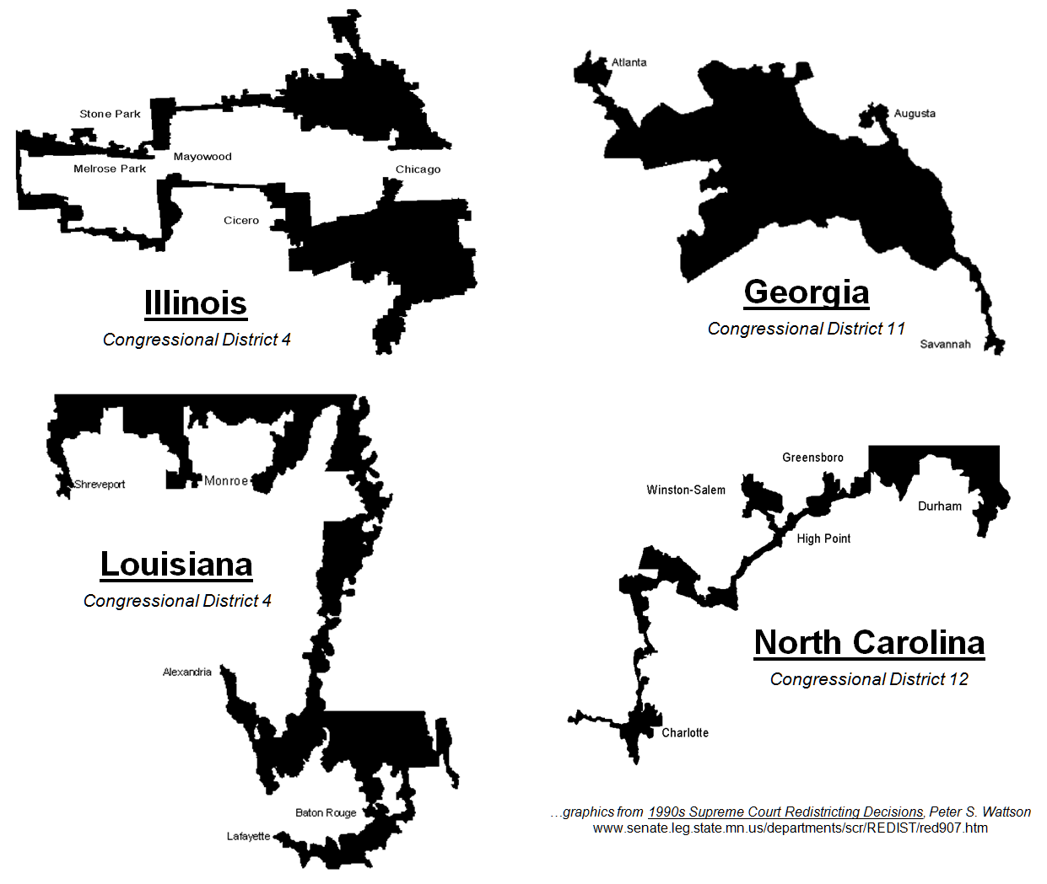
Redrawing electoral boundaries to give one political party an advantage is called gerrymandering.
The spatial organization of electoral geography can have a profound effect of power structures within a state.
Notes:
Internal political boundaries are often the subject of debate and manipulation.
Gerrymandering is illegal but even as late as the 1990’s North Carolina was questioned of gerrymandering districts.

Slide 73
Notes:
Gerrymandering video

Slide 74
Effects of Gerrymandering
Advantage/Disadvantage to a particular party
Creates Minority/Majority districts
Community unrest

Slide 75
Colonialism and imperialism

Slide 76
What is imperialism?
First started in the 15th century

Slide 77
Wanted colonies due to the concept of mercantilism
Notes:
Colonies provide resources and raw materials to ship back home to make products

Slide 78
Dependancy Theory- many countries are poor because of the colonization by the European powers
Political boundaries were set based on resources available to the colonizers not according to any cultural groupings of the native people.

Slide 79
Supranational organizations

Slide 80
Supranational Organizations refer to entities in which three or more countries form an alliance for cultural, economic, or military reasons.
Created so states can collectively reach a common goal that they may not be able to reach independently.
If a country threatens other states, the affected supranational organizations may impose international sanctions or punishments in the form of economic and/or diplomatic limits or even isolation
Notes:
If a country threatens other states, the affected supranational organizations may impose international sanctions or punishments in the form of economic and/or diplomatic limits or even isolation.
The growth of supranational alliances challenges conceptions of state sovereignty. To join such an alliance, state must give up some powers they have to the organization. But states realize that they need to cooperate to keep their borders secure and to guarantee economic and trade advantages so they join with other countries to provide these benefits.

Slide 81
Examples
The UN
NAFTA
OPEC
European Union
ASEAN
Notes:
North American free trade agreement
Organization of petroleum exporting countries
Association of south east asian nation

Slide 82
The United Nations
Started with only 49 nation-states in 1945, has grown to 192 members.
Membership is voluntary, but the body has limited-powers to force its members to abide by peace keeping principles.
The Security Council (The U.S., Great Britain, France, China, and Russia) can establish a peace-keeping force in a hotspot and request states to contribute military forces.
Contains many sub-organizations that promote general welfare and monitor world trade and economics.
Notes:
Closest structure to a world government on the earth.
Headquarters are located in New York City on a plot of land considered international territory.
UN charter states it’s purposes are “to maintain international peace and security; to develop friendly relations among nations; to cooperate in solving international economic, social, cultural, and humanitarian problems and in promoting respect for human rights and fundamental freedoms; and to be a centre for harmonizing the actions of nations in attaining these ends.”

Slide 83
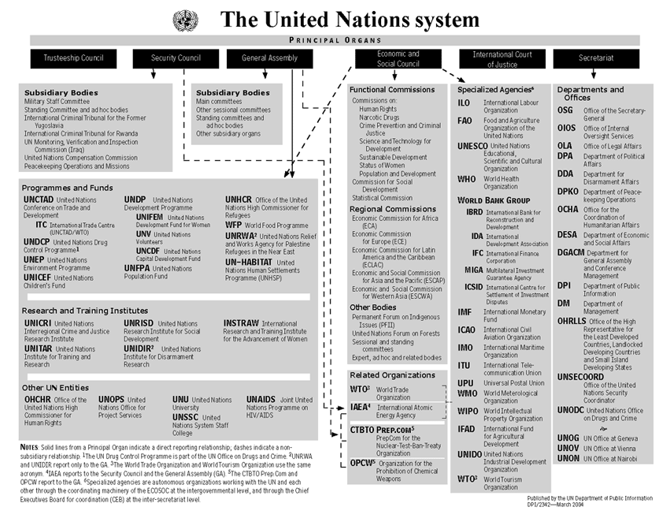
Notes:
Trustee to oversee colonies turning into independent nations
General assembly like congress
Economic and social council – coordinates all the work done by the organizations
International court of justice – is a court but only when all parties agree to appear in court
Secretariat – administrative section does day to day work

Slide 84
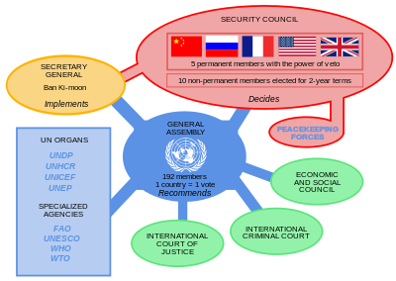

Slide 85
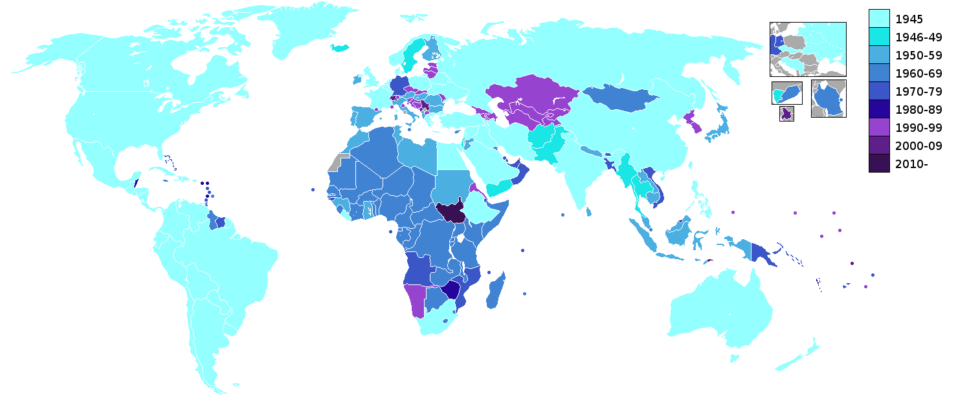

Slide 86
Non-governmental organization (NGO)
Refers to organizations that are neither a part of a government nor conventional for-profit businesses.
Usually set up by ordinary citizens, NGOs may be funded by governments, foundations or businesses
Ex:
Notes:
The number of NGOs operating in the United States is estimated at 1.5 million.
Examples – WWF (World Wildlife Fund) or American Cancer Society

