Slide 1
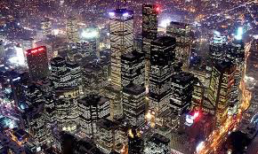
Cities and Urban Land Use

Slide 2
Model posters
Creator
What does it explain?
How is it used?
Illustration
Strengths
Weaknesses
Effectiveness
Example
Notes:
Concentric zone model, multiple nuclei model, Sector model, Latin American city model, Peripheral model,

Slide 3
Explain the location of cities.
Describe the growth of your local metropolitan statistical area.
What kinds of features are needed to support urban development?

Slide 4
Urbanization
Urbanization is the growth and diffusion of city landscapes and urban lifestyles.
While most MDCs are highly urbanized, the # and % in less developed countries is growing.
Eight of Ten of the most populous cities are currently in LDCs –
In MDCs about ¾ of the people live in urban areas, compared to about 2/5 in LDCs.
Notes:
Rate Vs. level

Slide 5
Increasing Percentage of People in Cities
The percentage of people living in cities increased from:
1800 – 1%
1850 – 6%
1900 – 14%
1950 – 30%
2000 – 47%
The population of urban settlements exceeded that of rural settlements for the first time in history in 2008.

Slide 6
Defining A City
Geographers have a hard time defining what is a city ….
In the 1930s, Louis Wirth, a social scientist, defined a city as a permanent settlement that has three characteristics:
Large Size – can only know a small % of the people
High Population Density – each person plays a specific role and encourages people to compete for survival in limited space
Social Heterogeneous – has greater freedom but may feel lonely and isolated

Slide 7
Legal Definition of a City
The term city defines an urban settlement that has been legally incorporated into an independent, self-governing unit. A city has:
Locally elected officials
Ability to raise taxes
Responsibility for providing essential services

Slide 8
Each settlement has an economic base
Basic Services create goods to be distributed outside of the community.
big industries
Paper Mill
USAA Insurance
QVC
Non-Basic Services: serve the community.
schools
Grocery stores
Doctors
DMV
restaurants

Slide 9
Basic or Non-Basic?
1. Hardees
2. Planters Peanuts
3. Fort Bragg
4. NCSU
5. Ford Plant
6. U-Haul distributer
7. Holly Springs High School
8. Cook-out
9. The International Port
10. Myrtle Beach oceanfront
11. Hendrick Dodge
12. Lipton Tea

Slide 10
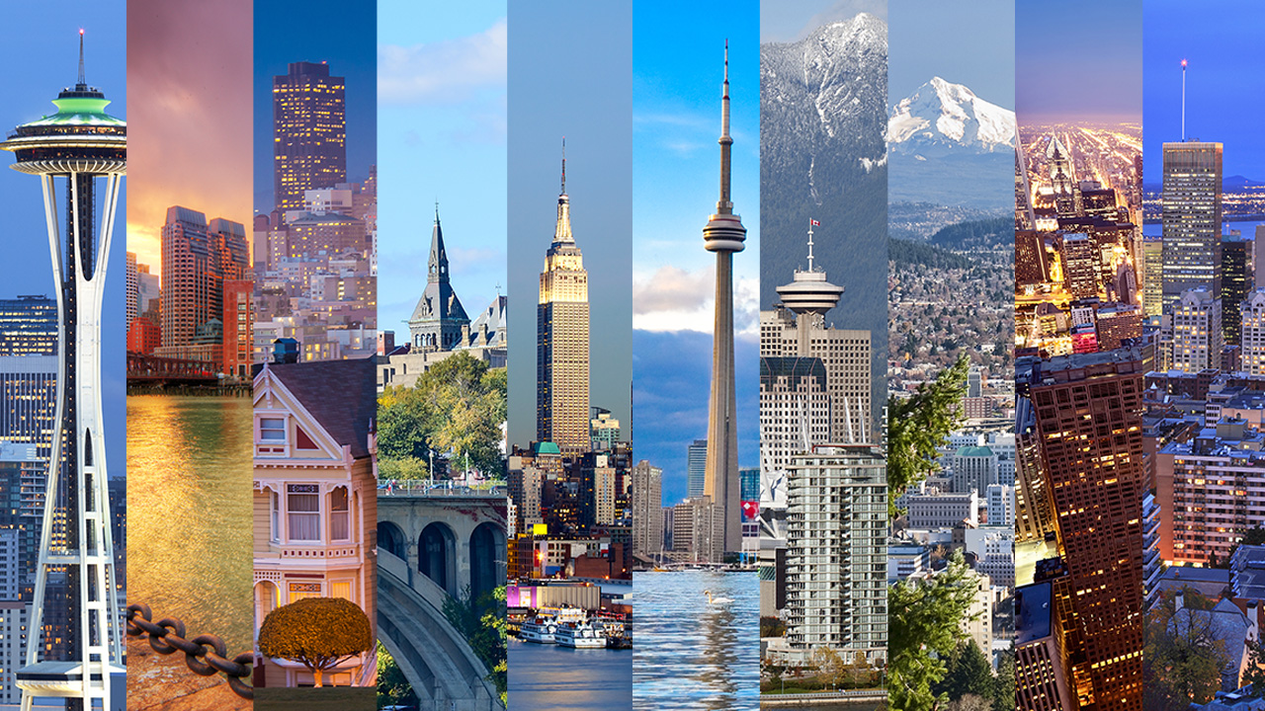
The 10 World’s Largest Cities

Slide 11
Metropolitan Statistical Area (MSA) Micropolitan Statistical Area
The US Census uses the term Metropolitan Statistical Area to identify a central city and all of its immediately interacting regions.
An MSA has a minimum of 50,000 people in it.
The US Census also uses the term Micopolitan Statistical Area that is an area of the surrounding counties integrated into a central city with a population of 10,000-50,000.

Slide 12
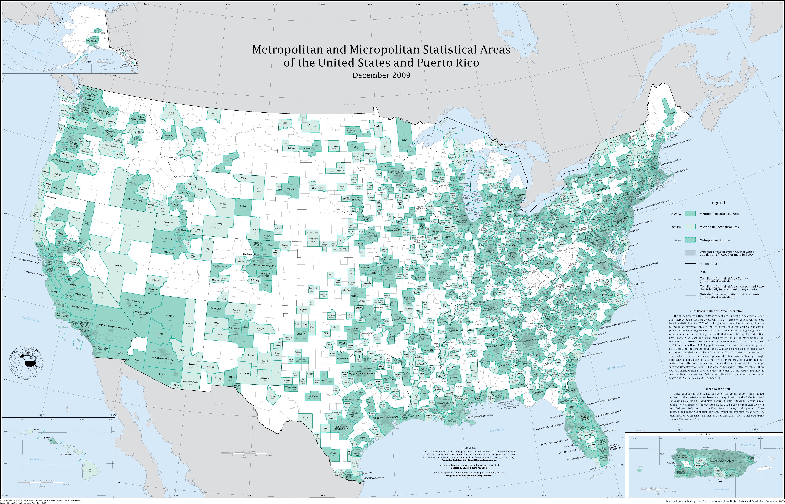

Slide 13
Megalopolis
Often the boundaries of MSAs will overlap. Such a massive urban “blob” of integrating metropolitan areas whose boundaries are difficult to find was named megalopolis by geographer Jean Gottmann.
Originally referring to fusing of DC and Boston.
Local Example – The “Triangle”
Other Examples – Great Lakes region, LA to Tijuana, German Ruhr, Randstad in the Netherlands, Japan’s Tokaido
Downtown areas remain distinct ….

Slide 14
Rate of Urbanization vs Level of Urbanization
Rate of Urbanization is the speed at which the population is becoming urban.
Level of Urbanization is the percentage of people already considered urban.
Example – level of urbanization in US is nearly 75% but the rate of urbanization is much lower than that of China which has a rapid rate of urbanization despite is low level of only 30%.

Slide 15
Urban Hearths
Urban Hearth Areas are places where urbanization first developed. Several qualities are common among the places that were urban hearths:
A dependable water supply;
A long growing season;
Domesticated plants and animals;
Plenty of building materials;
System of writing records.
Urbanization and the Evolution of Cities

Slide 16
Agricultural Urban Hearths
Trade-Based Urban Hearths
The earliest cities were born around 3500 BCE and were spawned from agricultural villages:
Mesopotamia
Indus River region
Nile Valley
Huang He River Valley
Mexico and Peru
Some cities grew as established marketplaces.
Spread westward throughout the Mediterranean region.
Spread eastward through overland and caravan trade routes to India, China, and then Japan.
Specialization began to occur as cities began to focus on goods over which they had a comparative advantage.
Greco-Roman Urban Hearths
Cities were the center of political control over conquered regions and were often built in a planned, grid-like pattern.

Slide 17
Pre-Industrial Cities
Pre-industrial cities are those that developed prior to industrialization and shared several characteristics:
Surrounding rural settlements provided food to urban dwellers who in turn provided different economic functions.
Served as trade centers and gateways to foreign lands and markets.
Had a diverse mix of economic functions in any given space.
Shops, markets, homes and government offices could be found jumbled together but economic segregation often existed between the elite and poor.

Slide 18
“Urban-Banana” of Pre-Industrial Cities
By the beginning of the 1500s, a majority of cities were located in trade-centers that extended from London to Tokyo, a line of cities known as the urban banana.
Powerful cities: London, Paris, Constantinople, Venice, Cairo, Nanking, Hanchow, and Osaka
Resulted from both site and situation factors:
Site factors: arable land, street layout, building materials
Situation factors: proximity to major trade routes and other urban places

Slide 19
Pre-Industrial Colonial Cities
Colonial cities were those built and developed by colonizers in conquered lands. With the growth of European imperialism, the European’s drive to grab foreign lands and resources fueled their construction and creation of cities in their conquered colonies. They shared common characteristics:
Wide boulevards and prominent, classical architecture
Constructed with the aim of exporting raw resources

Slide 20
Urban-Industrial Revolution Link
In 1800, only 5% of the world’s population lived in cities; by 1950, 16% lived in cities; by 2010, nearly 50.5% lived in cities.
The diffusion of the Industrial Revolution is largely responsible for urbanizing the world’s people, though at unequal levels.
75% of the world’s population living in MDC live in urban places
40% of the world’s population in LDC live in urban places

Slide 21
Industrial Revolution/2nd Agricultural Revolution
The European Industrial Revolution triggered the diffusion of city growth with a steady rural-urban migration pattern.
Urbanization grew in a snowball process, as growth of urban jobs provided attractive opportunities to rural people who struggled.
Supporting this pattern of industrial and urban growth was the demographic transition linked to the 2nd Agricultural Revolution (supplied more workers to the growing factories and improved food supplies to support increasing population).

Slide 22
The Industrial City
By the early 1900s, most of the world’s great cities were American or European industrial cities which grew during the Industrial Revolution.
Examples – Manchester, Chicago, Barcelona
Primary function was to make and distribute manufactured products.

Slide 23
The 10 Best Cities in the US
Notes:
Stop here

Slide 24
Shock Cities
This pattern of rapid growth led to urban spaces that were overwhelmed with the influx of urban in-migrants. Shock cities are urban places experiencing infrastructural challenges related to massive and rapid urbanization.
The challenging social, economic, and cultural changes included:
Slums
Hazardous pollution levels
Deadly fires
The growth of urban prostitution
Exploitation of children

Slide 25
Strained Infrastructure
An important trend in modern urbanization is its diffusion to less developed parts of the world.
Urbanization in less-developed countries is often focused on one or two cities rather than being spread evenly throughout.
Large migration streams of young adults moving from rural to urban areas puts a high number of opportunity-seekers into already strained places.

Slide 26
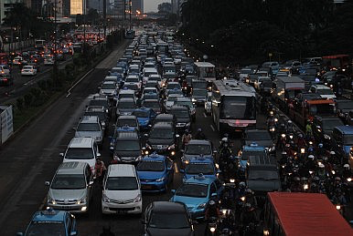

Slide 27
Squatter Settlements
Unable to find housing, many new migrants build squatter settlements (barriadas, barrios, favelas, bidonvilles, bustees …) – makeshift, unsafe housing constructed from any scraps they find on the land they neither rent nor own usually on the edge of the city.
They have few or no services. Generally they lack schools, paved roads, telephones, or sewers. Electricity is stolen.
At first they do little more than camp of the land or sleep in the street. Families erect primitive shelters and as they find materials the add them to their shacks.
To improve housing conditions they can – move illegally into better-quality, vacant housing or rent slum housing illegally from a landlord because there is a lack of affordable housing in the city to accommodate the rural to urban migration.
Percentage of people living in squatter settlements can range from 33% in Brazil to 85% in Ethiopia.
The Places We Live Website
Notes:
FRQ 2009 #2

Slide 28
Squatter Cities

Slide 29
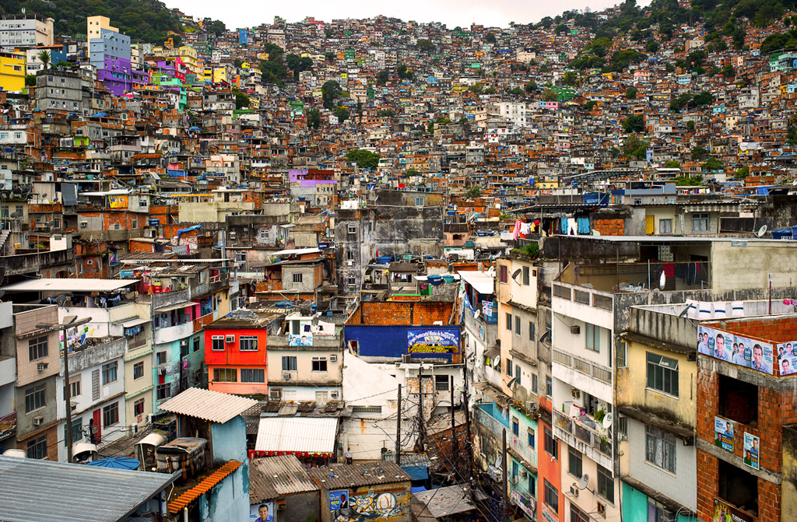

Slide 30
What can be done to fix it?
Why is this a major problem
# Problem
What will happen if this problem remains unchecked

Slide 31
Urban Systems
All urban places are part of an interlocking urban system of cities that operate within a network of spatial interaction. In other words, urban places interact with each other and are interdependent, not independent, and exist in a spider-web of interacting parts.

Slide 32
How far would you go …
To see your favorite band, singer, music group?
To have a meet and greet with a star (anyone you choose)?
To be at opening day of your favorite sports team?
To star in a reality show (or game show)?
To go on the vacation of your dreams?

Slide 33
Walter Christaller’s Central Place Theory
In the 1930s, German geographer Walter Christaller developed the central place theory as a means of studying the geographical patterns of urban land use, specifically looking to explain and predict the pattern of urban places across the map.
Based on the assumptions of:
flat land surface;
a uniformly distributed rural population;
equal transportation methods throughout.

Slide 34
Main Ideas of Central Place Theory
Central places are urban centers that provide services to their surrounding rural people, collectively referred to as the central place’s hinterland.
The threshold is the minimum number of people needed to fuel a particular function’s existence in a central place. [the more unique and special – the higher the threshold]
The range of a good or service is the maximum distance a person is willing to travel to obtain that good or service.
Spatial competition implies that central places compete with each other for customers. [people will travel to the closest available option to obtain the good or service wanted]

Slide 35
The Hexagonal Spatial Pattern
Higher-order central places contain economic functions with high thresholds and high ranges that require large populations to serve groups of lower-order central places existing around them.

Slide 36
The Gravity Model
The gravity model predicts that the optimal location of a service is directly related to the number of people in the area and inversely related to the distance people must travel to access it.
According to the gravity model, consumer behavior reflects two patterns:
The greater the number of people living in a particular place, the greater is the number of potential customers for a service.
The farther people are from a particular service, the less likely they are to use it.

Slide 37
Gravity Model

Slide 38
Urban Hierarchy
Urban hierarchy is a system of cities consisting of various levels, with few cities at the top level and increasingly more settlements on each lower level.
Position on the hierarchy is determined by the types of central place functions it provides.
Kuby # 9 – Take Me Out to the Ballgame: Market Areas and Urban Hierarchy

Slide 39
Central Place + Urban Hierarchy An Example
Over the last thirty years, populations in the US South and West have increased and become wealthier overall. With more people and wealth, more services were needed. Several cities stepped up to fill this need – Phoenix, Atlanta, and Dallas moved up on the urban hierarchy as they grew to offer more central place functions to the newly growing populations. As with any hierarchy, as these cities moved up the ladder, other cities moved to fill their places: cities like Tampa, San Antonio, and Charlotte moved up, while some older manufacturing cities in the Northeast and Midwest began to fall in their rankings within the urban hierarchy.

Slide 40
Rank-Size Rule
There is a relationship between a city’s population size and its place on the urban hierarchy within its urban system.
A city’s ranking in the urban hierarchy can be predicted by the rank-size rule, which states:
N^{th} largest city = 1/n the size of largest city
The largest city has 10 million
The next city has 5 million
The next city has 3.33 million
Notes:
1. New york – 8175133
2. LA – 3792621
3. Chicago – 2695598
4. Houston – 2099451
5. Philly – 1526006
43. Raleigh - 431746

Slide 41
Primate Cities
Cities with primacy are more than two times the size of the next largest city and exert political, social and economic dominance.
Example – Buenos Aires, Argentina is nearly 10 times the size of its second largest city, Rosario.
Positives of Primate Cities:
Advantages of agglomeration of economic activity.
Large market for goods and services.
Ability to offer high-end goods and services (including education) because of larger threshold population.
Advantages of centralized transportation and communication network.
Global trade opportunities; primate cities can compete on a global scale and attract foreign investment.
Negatives of Primate Cities:
Unequal economic and/or resource development.
Unequal distribution of wealth and/or power.
Transportation network (hub and spoke) prevents equal accessibility to all regions.
Impact of centrifugal forces and difficulties of political cohesion on economic development.
Brain drain — migration and unequal distribution of education, entrepreneurship, opportunities.
Notes:
FRQ # 1 (2011)

Slide 42
Centrality
Additionally, when a city dominates economic, political, or cultural functions more than you would expect based on its population size, the city also demonstrates a high degree of centrality, or the possession of central place functions.
Example – Managua, Nicaragua accounts for only 30% of the total population but controls nearly 40% of the country’s economy.

Slide 43
World Cities
In the interlocking, interacting network of cities throughout the world, there exist some world cities, powerful cities that control a disproportionately high level of the world’s economic, political, and cultural activities.
Sometimes called global cities, they have a high degree of centrality.
The physical location of a world’s city is less important than its ability to be a prominent node in the global communications infrastructure.
Examples – London, New York, Tokyo

Slide 44
Pan-Regional Influence
World cities have pan-regional influence, a reach that extends beyond the city’s own region into the other centers of economic control.
Example – New York City
Range extends beyond North America into the other two centers of economic control, Europe/Africa/Middle East and Asia/Oceania.
Home to powerful media outlets, financial institutions, global corporations headquarters, and political organizations like the UN.

Slide 45
Hierarchy of Business Services
Geographers distinguish four levels of cities that play a major role in the provision of producer and other business service in the global economy.
World Cities – law, banking, insurance, accounting, and advertising concentrate in large numbers
Command and Control Centers – headquarters of large corporations, business services, educational, medical, and public institutions
Specialized Producer-Service Centers – narrow and highly specialized variety of services
Dependent Centers
Resort, Retirement, and Residential Centers
Manufacturing Centers
Industrial and Military Centers
Mining and Industrial Centers

Slide 46
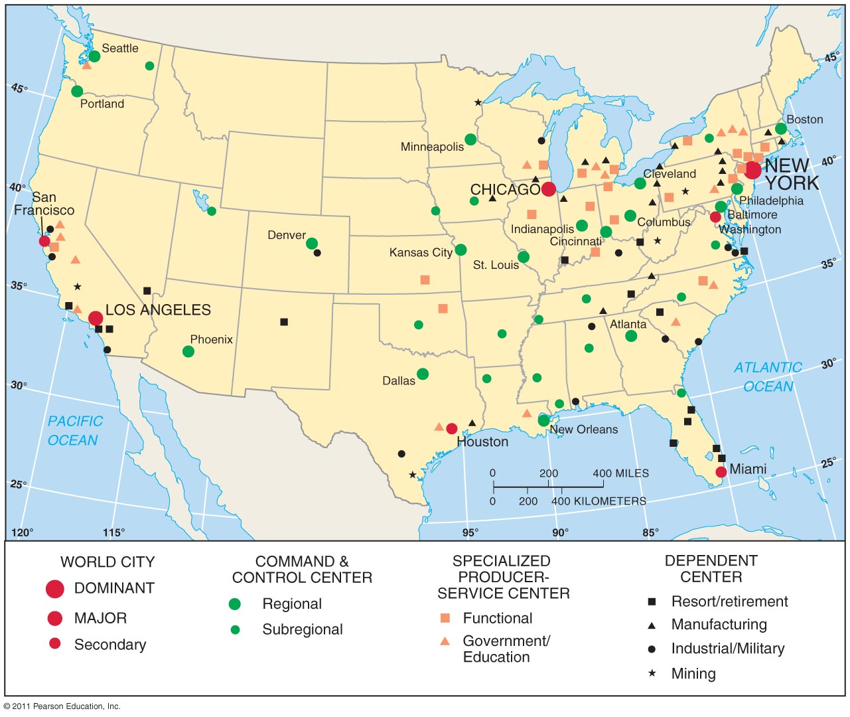

Slide 47
Megacities
Though not considered world cities, megacities have a high degree of centrality and primacy, thereby exerting high levels on influence and power in their countries economies.
All megacities have over 10 million inhabitants.
Examples – Beijing, Cairo, Mexico City, and Jakarta
Notes:
City planning simulation

Slide 48
Borchert’s Model of Urban Evolution
In the 1960s, Samuel Borchert studied cities in the US and linked changes in transportation technology to urban evolution.
Stage 1: “sail-wagon era” of 1790-1830, cities mostly near ports and waterways.
Stage 2: “iron-horse cities” of 1830-1870, when the railroad and steam boats were rapidly spreading.
Stage 3: “steel-rail epoch” of 1870-1920, industrial cities blossomed
Stage 4: cities of 1920 that were intricately linked to car and air travel leading to rapid spread of suburbs

Slide 49
Central Business District
All of the comparative models of North American cities possess a central business district (CBD), or original core of a city’s economy, like the nucleus of a cell.
Consumer and business services are attracted to the CBD because of its accessibility. Three types of retail services concentrate in the CBD:
Shops with high threshold
Shops with long range
Shops that serve people who work in the CBD
The accessibility produces extreme competition for the limited sites available. As a result, land value in the center is very high. Also have given it a three dimensional character, pushing it vertically.

Slide 50
Activities Excluded from the CBD
High rents and land shortages discourage two principle activities in the central area – manufacturing and residence.
Business have moved to suburbs. Manufactures have selected peripheral locations because land costs are lower. Services providers have moved to the suburbs because most of their customers are there.

Slide 51
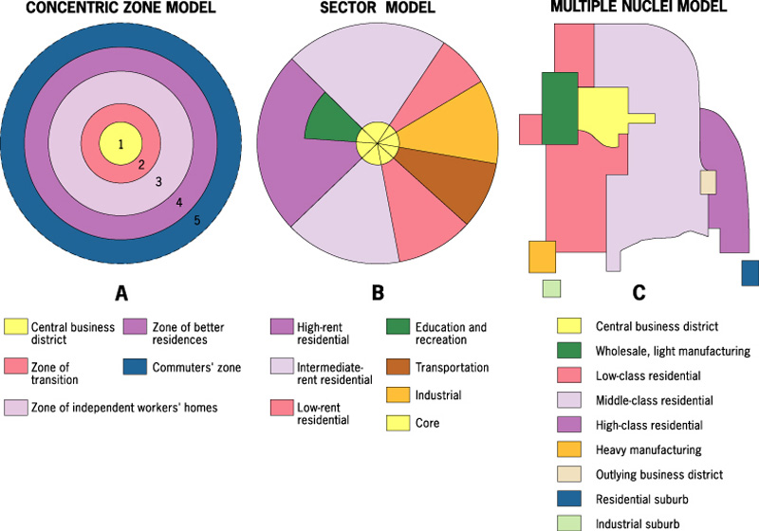
Models of Urban Structure help to explain where different types of people live in an urban area

Slide 52
Concentric Zone Model
Developed in the 1920s by E.W. Burgess, the concentric zone model was the first model to explain and predict urban growth.
Based on urban growth in Chicago.
Model suggest that a city’s land use can be viewed from above as a series of concentric rings.

Slide 53
Concentric Zone Model Continued
Assumes a process called succession migration in which new arrivals to cities tend to move first into the inner rings, near the CBD, which pushes that already present into farther rings.
Because of this constant invasion there exists a ring, known as zone in transition, just outside of CBD that never becomes developed (skid row).

Slide 54
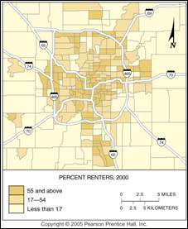
Example of concentric zone model in Indianapolis, the distribution of renters. The percentage of households that rent their home is greater near the CBD and less in the outer rings.

Slide 55
Bid Rent Curve
The CBD is the premiere land-use ring nearest the point of maximum accessibility and visibility in the city, a point known as the peak land value intersection.
The bid-rent curve predicts that land prices and population density decline as distances from the CBD increases.

Slide 56
Density Gradient
As you travel outward from the center of a city, you can watch the decline at which people live. This density change in an urban area is called the density gradient. According to this, the number of houses per unit of land diminishes as distance from the center of the city increases.
Two changes have affected the density gradient in recent years.
The number of people living in the center has decreased. (thus there is a gap in the center where few live)
There is a trend toward less density difference within urban areas.

Slide 57
Sector Model
In the 1930s. Hoyt discovered a twist on the concentric zone pattern, known as the sector model.
Grew out of observations that there were urban land-use zones of growth based on transportation routes and linear features.
Explained that similar land uses and socioeconomic groups clumped in geometric sectors radiated outward from the CBD.

Slide 58
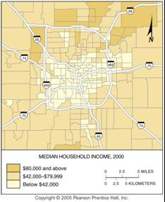
Example of sector model in Indianapolis, the distribution of high income households. The median household income is the highest in a sector to the north, which extends beyond the city limits to the adjacent county.

Slide 59
Multiple-Nuclei Model
By the late 1940s, Chauncy Harris and Edward Ullman discovered the multiple-nuclei model which suggested that growth occurred independently around several major focal points.
These focal points may be distant from the CBD and only loosely connected to it.
Recognized that land use zones often popped up at once, in chunks.
Does not suggest that the CBD is unimportant, but it does show that new area can grow simultaneously.

Slide 60
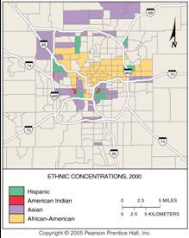
Example of multiple nuclei model in Indianapolis, the distribution of minorities. The African American concentration consists of census tracts that are 90 percent or more African Americans. The other groups are clustered in tracts that contain at least 5 percent of the total Indianapolis population of that ethnic group.

Slide 61
Urban Realms Model
As the automobile became increasingly prevalent, the urban realms model was developed in the 1960s by James Vance to explain suburban regions that were functionally tied to mixed-use, suburban downtowns with relative independence from the CBD.
The urban realms model recognized that many people’s daily lives and activities occurred within a fixed activity space, or urban realm, and that within the realms one could find suburban downtowns, filled with all the amenities needed.

Slide 62
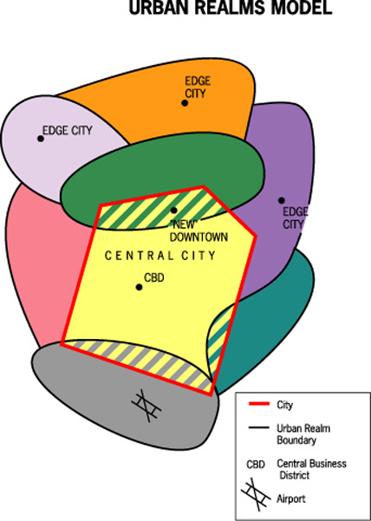

Slide 63
Latin American Cities Model
Larry Ford and Ernest Griffin created a model of the pattern of urban growth in Latin America.
Commercial and residential zones encircled the Latin American plaza, similar to the CBD in the North American city.
In the Latin American city, wealth typically decreases as one moves outward from the downtown area.
Perifericos are zones of peripheral squatter settlements because massive numbers of migrants from rural regions move toward urban areas.
A zone of in situ accretion is a region transitioning that is a mix of middle-income and lower-income families.
A zone of maturity includes services and infrastructural development.

Slide 64
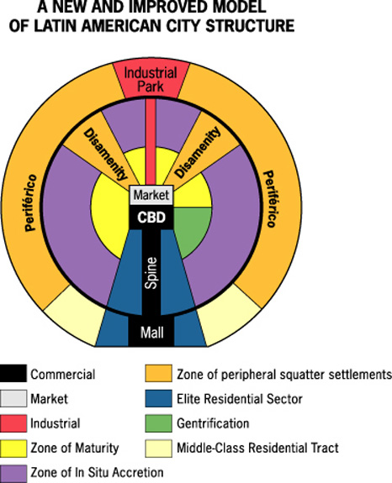

Slide 65
European Cities
As in the US, wealthier people in European cities cluster around a sector extending out from the CBD.
However, in contrast to most US cities, wealthy Europeans still live in the inner rings of the upper-class sector. Central location provides proximity to the best shops, food, and cultural facilities.
People with lower incomes have been relegated to the outskirts of cities. Vast suburbs containing dozens of apartments house people displaced from the inner city. Residents face long commutes by public transportation to reach jobs and amenities.

Slide 66
Counterurbanization and Exburbs
Counterurbanization is the increase in rural populations that result from the out-migration of city residents from the city and suburban homes in search of non-urban lifestyles.
In the 1950s, geographers saw the growth of exburbs, or rings of wealthier rural communities that grew just outside of the suburbs.
Early inhabitants commuted via parkways systems and commuter rails.
Now many practice telecommuting that involves the commuting only of information, not the worker.
Suburban Sprawl Vocabulary Challenge

Slide 67
Urban Sprawl
Urban sprawl is the diffusion of urban land use and lifestyle into formerly non-urban, often agricultural lands.
Led to the growth of what Joel Garreau called edge cities, self-sufficient, urban villages that often develop at highway exists and are part of a larger, metropolitan complex.

Slide 68
Contribution of Transportation to Suburbanization
Urban sprawl makes people more dependent of transportation for access to work, shopping, and leisure activities.
The suburban explosion in the 20th century has relied on motor vehicles rather than railroads. Vehicle ownership is nearly universal now.
Outside the big cities, public transportation is extremely rare of nonexistent. The vehicle is an important user of land in the city. An average city allocated about ¼ of its land to roads and parking lots.
The intense concentration of people in the CBD during working hours stains transportation systems because a large number of people must reach a small area of land at the same time.
In large cities, public transportation is better suited that vehicles to moving large numbers of people. It is cheaper, less polluting, and more energy efficient than vehicles. Despite its advantages only 5% of work trips are made by public transportation.
Kuby # 11 – The Disappearing Front Range: Urban Sprawl in Colorado

Slide 69
Annexation
Suburbs and edge cities often fight for independence from the metropolitan governments so that their inhabitants can have their own mini-governments and tax bases.
Central cities often find themselves surrounded and “strangled” by independently governed suburbs, leaving the inner cities with a limited tax base.
Economic problems are exacerbated by their inability to annex peripheral land. Annexation is the process of legally adding land area to a city.
Usually land can be annexed only if a majority of residents in affected area vote in favor of doing so.

Slide 70
Suburban Segregation
The modern residential suburb is segregated in two ways.
Residents are separated from commercial and manufacturing activities that are confined to distinct and compact areas. Zoning Ordinances encouraged spatial separation by preventing the mixing of land uses within the same district.
Housing in a given suburban community is usually built for people of a single social class, with others excluded by virtue of cost, size, or location. The strongest criticism is that low-income people and minorities are unable to live in them because of the high costs (and unfriendliness of residents).

Slide 71
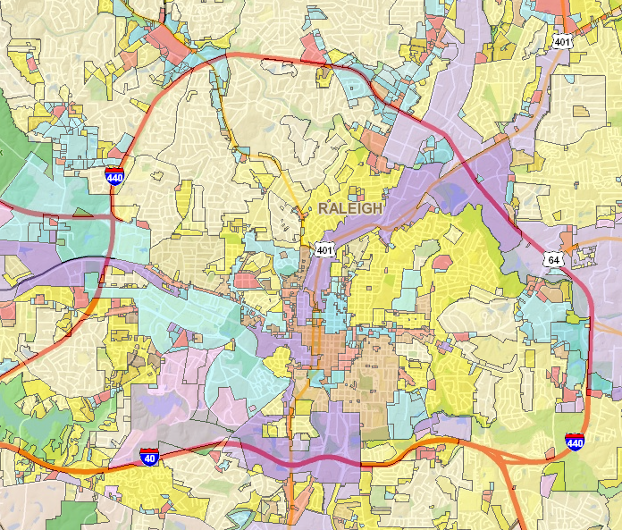
Notes:
10 smartest cities

Slide 72
The 10 Smartest Cities in the World

Slide 73
Uneven Development
Uneven development refers to urban development that is not spread equally among a city’s areas, leaving some areas richly developed and others continually poor and decrepit.
Often caused by cumulative causation, when money flows to areas of greatest profit, places where development has already been focused, rather than to places of greatest need.

Slide 74
Ghettoization
Ghettoization refers to the growth of areas of concentrated poverty.
The process of sub-division of houses and occupancy by successive waves of lower income people is known as filtering. The ultimate result of filtering may be abandonment of the building.
Real Estate developers and banks contributed to and sometimes profited from ghettoization in three ways:
Blockbusting when agents used racism to “bust up” a block by bringing in a minority family into a predominantly white neighborhood and then profiting from all of the turnover.
Racial Steering when agents would intentionally or unintentionally steer people to buy a home in a neighborhood based on their race.
Redlining when banks would refuse to give loans to certain minority-occupied neighborhoods that were “redlined” (lines drawn on a map).

Slide 75
Public Housing
Many substandard inner-city houses have been demolished and replaced with public housing, which is reserved for low-income households who must pay 30% of their income for rent.
Local government manages the building but federal money pays for construction.
In US accounts for less than 2% of all dwellings.
Most of the high-rise projects were built in the 1950s and 1960s. Now cities are experimenting “scattered-site” public housing.
Federal government has now stopped the funding of new public housing.

Slide 76
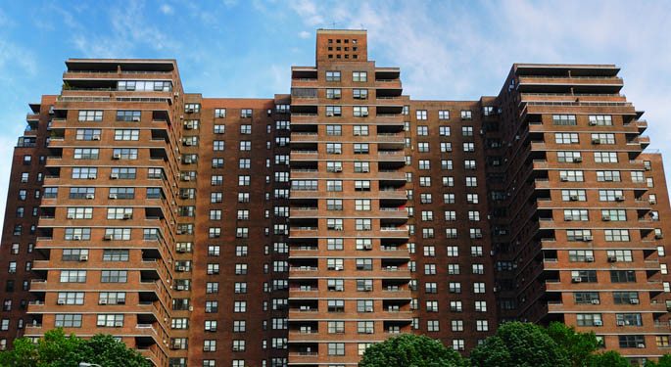

Slide 77
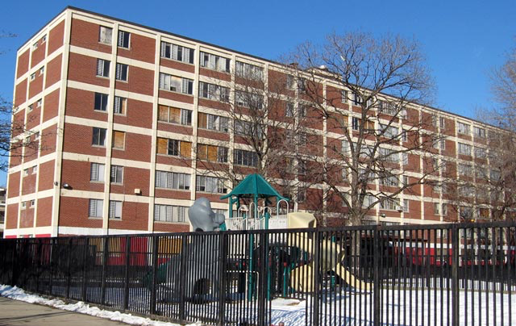

Slide 78
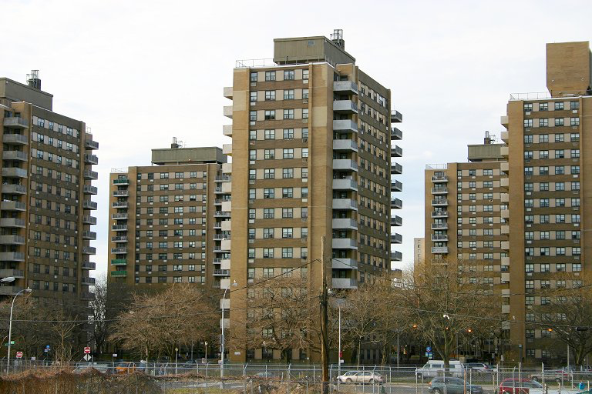

Slide 79
Gentrification
Gentrification is a process wherein older, urban zones are “rediscovered and renovated” by people who move back into the inner city from the suburban fringes.
Brings money into inner-urban areas thought to be underdeveloped and poorer.
Many see it as a great solution to recharging a city’s inner core that was suffering due to suburbanization (growth of suburb neighborhoods and commuter families) and the continued flight of wealthier classes out of the inner city.
Attracted to middle-class people who work downtown and those who seek proximity to facilities, especially those without kids.
Critics see it as only increasing uneven development by pushing lower-income families from their homes in order to build buildings that only the rich can afford.
Fish in the ‘Hood – The Washington Post

Slide 80
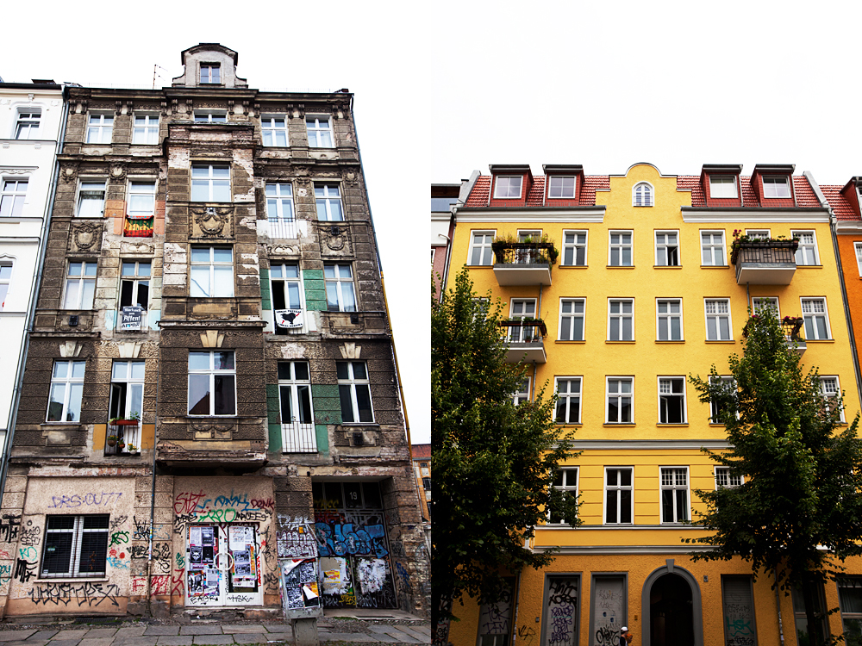

Slide 81
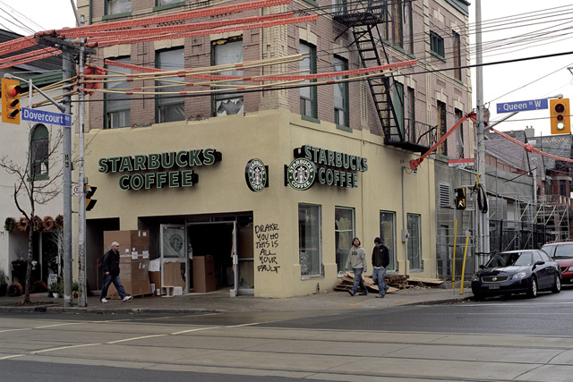

Slide 82
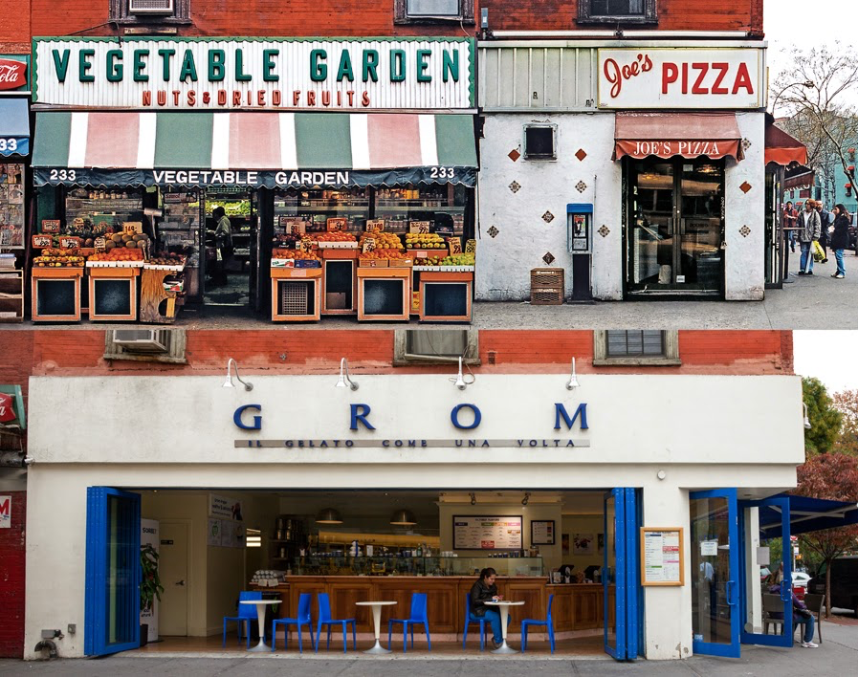

Slide 83
Containing Urban Sprawl
European cities (like London) have worked to limit urban development to a particular area by installing a green belt, a boundary that forces all urban development to occur within the city’s urban core.
North American cities have a difficult time setting such boundaries because they can attract investors who want to develop these lands and grow the city at the expense of rural lands.

Slide 84
Neo-Urbanism
Neo-urbanism is a movement to bring together trends in healthy living, sustainable growth, and urban development.
One neo-urban trend includes constructing planned communities, neighborhoods with master-planned housing designs, walkable pathways, recreational facilities, and security features.
Health experts are encouraging developers to build in pedestrian walkways to reduce disease.
Many recent designs include festival settings, or large recreational areas for communities.
Before I die …. Ted Talk

Slide 85
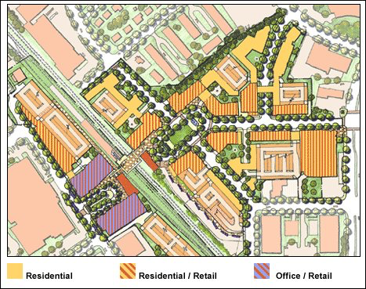

Slide 86
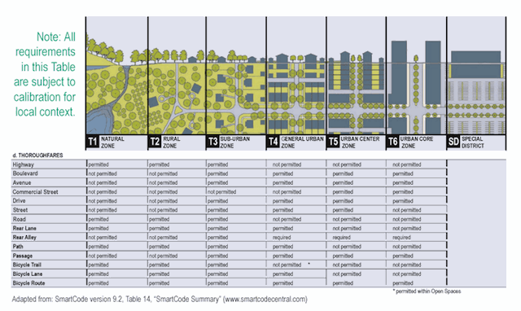

Slide 87
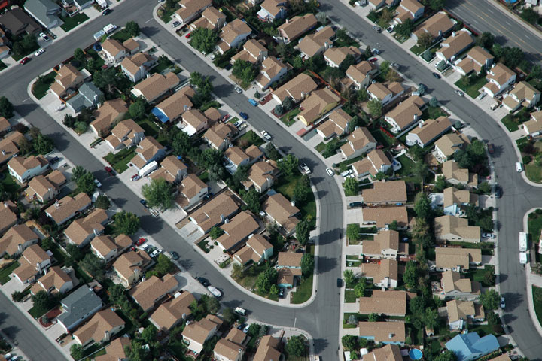
Notes:
Vocab

Slide 88
Illustrated review
Term – Definition as it applies to Human geography in your own words
Illustration colorful
Application – Real world example/Advantage and disadvantage/how it works/
On the notecard write the biggest idea/most important concept you think is necessary for this class.

