Slide 1
Warm-Up
What makes something a “revolution”?
Review for your Africa II Map Quiz

Slide 2
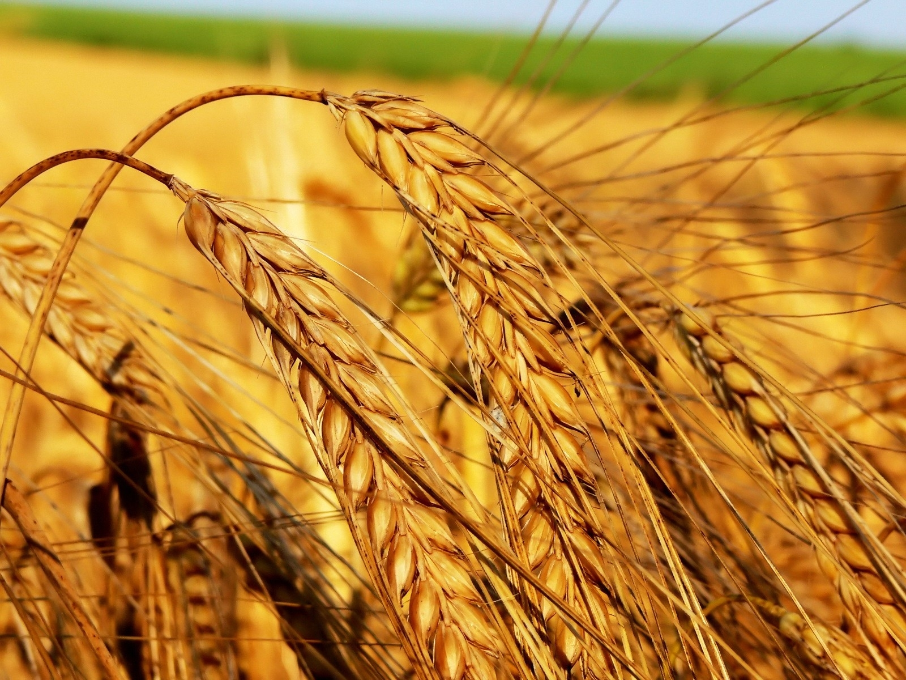
Agricultural Revolutions

Slide 3
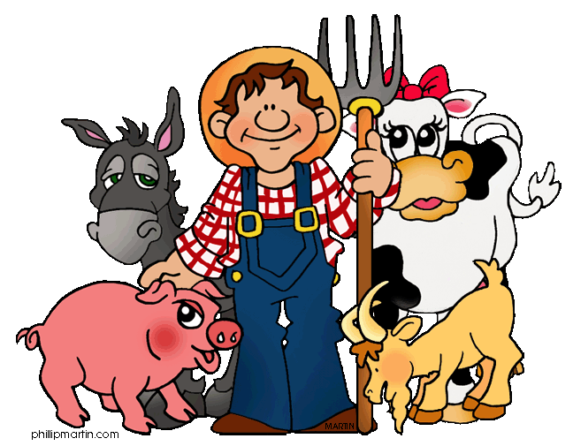
Agriculture is the deliberate tending of crops and livestock in order to produce food and fiber.

Slide 4
The History of Agriculture

Slide 5
Seed planting is the production of plants through the planting of seeds where vegetative planting is where new plants are created from existing plants.
Began with cutting the stems off of another plant or dividing the roots and later they made the leap to seed agriculture which leads to higher yields.

Slide 6
The Neolithic Revolution The First Agricultural Revolution

Slide 7
The Neolithic Revolution was the drastic changes that occurred when people began to cultivate crops and domesticate animals.
Humans were able to stay in one place, grow their populations and start to build communities.

Slide 8
The Neolithic Revolution
Increase in Reliable Food Supply
Rapid Increase in Human Population
Job Specialization
Larger Gender Differences (Patriarchal)
A divide between nomads and settled people

Slide 9
Hearth | Diffusion Route | Crop Innovation
Western India | To Southwest Asia | Wheat and Barley
Southwest Asia | To Europe, North Africa, and to Northwestern India and Indus River area | Integrated seed agriculture with domestication of herd animals
Northern China | To Southwest Asia and Southeast Asia | Millet
Ethiopia | Remained Isolated in Ethiopia | Millet
Southern Mexico | Throughout Western Hemisphere | Squash and Corn
Northern Peru | Throughout Western Hemisphere | Squash, Cotton, Beans

Slide 10
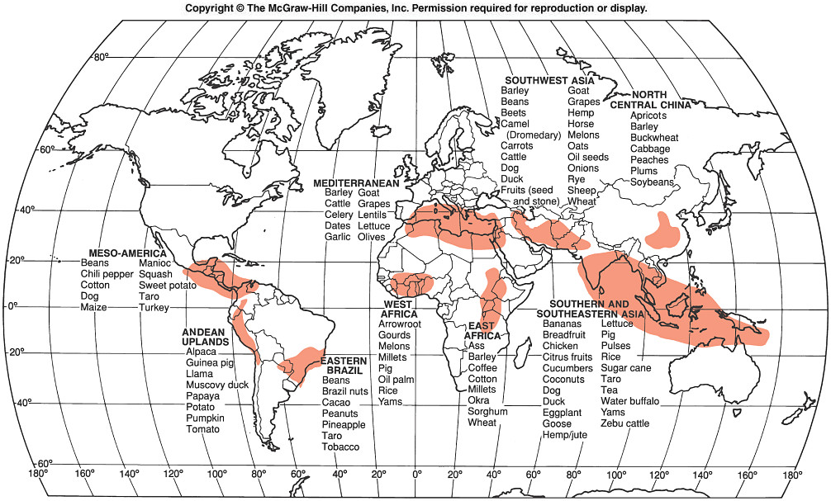
Crop Hearths

Slide 11
Vegetative Planting Hearth and Diffusion

Slide 12
Seed Planting Hearth and Diffusion

Slide 13
Terracing In Nepal

Slide 14
The Columbian Exchange is when products began to be exchanged between the western and eastern hemispheres.

Slide 15
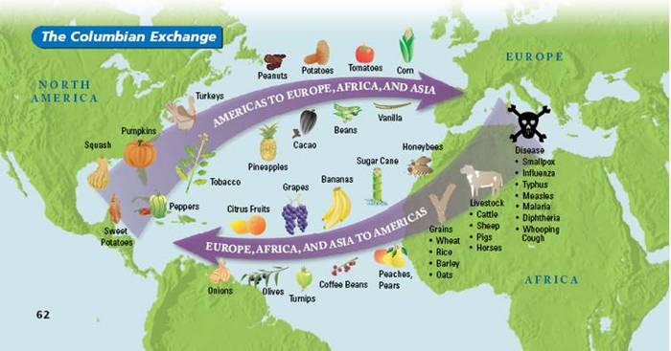

Slide 16
The Second Agricultural Revolution

Slide 17
The Second Agricultural Revolution began in Western Europe in the 1600s. It intensified agriculture and promoted higher yield per acre.

Slide 18
Second Agricultural Revolution
-coincides with the industrial revolution
-demands for food production were large-scale
Dramatic improvements in crop and livestock yields
Improved yoke for oxen and replaces ox with horse
New inputs like fertilizers and field drainage systems
Communal farming systems replaced by enclosed land run by individuals

Slide 19
Enclosure
Crop Rotation
Jethro Tull’s Seed Drill
Industrial Revolution
Refrigeration
Fertilizers, Weed Killers, Pesticides
Notes:
As capitalism grew, villages enclosed their land and individual farmers began to farm their own plots of farmland. Many people began to move into the cities and this caused a great jump in the demand for food from farms to be shipped into the cities for workers. With this growth in demand came new innovations in farming.

Slide 20
The Third Agricultural Revolution

Slide 21
The Third Agricultural Revolution began in the late 20th century and is characterized by the industrialization of agriculture, biotechnology, and the Green Revolution.
Agribusiness is the combination of the various pieces of the food production industry, including the farms, processing plants, packages, fertilizer labs, distributors, and ad agencies.

Slide 22
The Third Agricultural Revolution
-Mechanization
-Chemical Farming with synthetic fertilizers
-Food manufacturing on a global scale

Slide 23
The Green Revolution involved the practice of using higher yield seeds and expanded use of fertilizers to increase production.
Dramatically increased the crop output possible on every farm.
Began with agricultural experiments in the 1940s that were funded by US charities to find ways of improving Mexico’s wheat grain production capabilities to reduce hunger in that region.

Slide 24
Economic Downsides
Reduced amount of labor needed which has cut jobs.
Strains are often prone to viruses and pest infections leading to crop failure.
Environmental
Downsides
Pesticides have caused pollution and soil-contamination.
Require more water so it strains water resources.
Many crops are not farmable in dryer African regions.
Local farmers have a hard time purchasing more-expensive seeds.
Workers are exposed to chemicals suffer health problems.
Requires more mechanized equipment that uses more expensive fuels which increases pollution.

Slide 25
Praise
Agriculture now outpaces population.
Nitrogen-based fertilizers increase farm productivity.
Scientists continue to invent new food sources.
Higher productivity reduces dependency on imports in places such as China and India
New Irrigation have increased crop yields.
Agribusiness has increased the productivity of cash crops

Slide 26
Biotechnology is using living organisms to produce or change plant or animal products.
Also called genetically modified.
Recent innovations have led to super plants that grow at faster rates even in poor soil.
Notes:
Benefits:
Enhanced taste, reduced maturation time, improved resistance to disease, better yield
Criticisms:
Potential human health impacts and environmental impacts, tampers with nature, stress for animal

Slide 27
Peeling Back the Label
USDA Organic: To earn the label, foods must be produced without the use of synthetic pesticides, herbicides, fertilzer’s, sludge, irradiation, or genetically modified seeds, according to the agency. Cows must have access to pasture a minimum of 120 days per year.

Slide 28
Countries Ranked by Agricultural Output, 2009
Rank | Country | Output in Millions
1 | China | 520,352
 | European Union | 312,498
2 | India | 210,116
3 | United States | 171,075
4 | Brazil | 96,016
5 | Japan | 81,089

Slide 29
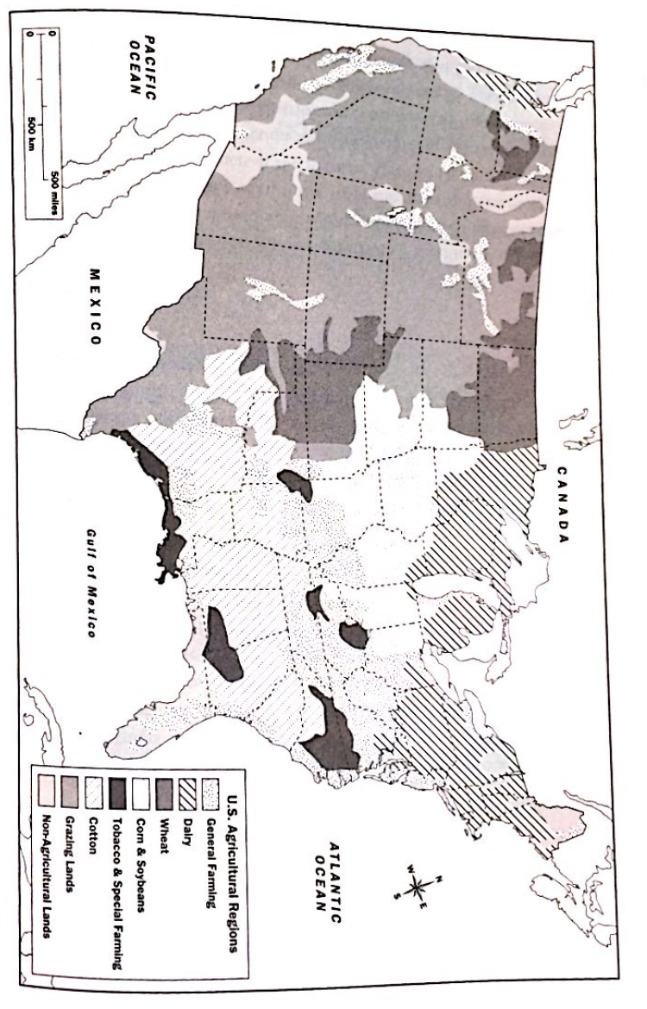

Slide 30
Subsistence vs Commercial Farming

Slide 31
Percentage agricultural Primary Economic Activities

Slide 32
Subsistence Agriculture is most prevalent in LDCs and produces no surplus. Commercial Agriculture is the production of surpluses with the intention to sell.

Slide 33
Subsistence Agriculture
Producing food needed to survive on a daily basis
Near total self-sufficiency – predominant occupation of mankind today
2 types:
Extensive
Intensive

Slide 34
Differences
Subsistence
Higher percentage of farmers.
Labor Intensive
Commercial
Low percentage of farmers.
Capital Intensive
Extensive
Intensive
Notes:
Intensive – small size/ Extensive large amounts

Slide 35
Subsistence Farming
Notes:
Can be intensive – uses small amount of land or extensive – uses a large amount of land

Slide 36
Intensive Subsistence
Yields Large Amounts of Output Per Acre
Found in Large Population Concentrations: East and South Asia
Dominated by Wet or Lowland Rice
Notes:
Many practice double cropping or planting and harvesting a crop on a field more than once a year.

Slide 37
Intensive Subsistence: involves the efficient use of a small parcel of land in order to maximize crop yield Large amounts of Human labor and fertilizer Asia: India, China and Southeast Asia

Slide 38
Subsistence Wet Rice
Notes:
Slow life in japan

Slide 39
Even in MDCs, Intensive-subsistence wet rice can still exist http://www.pbs.org/frontlineworld/rough/2005/11/japan_the_slow.html

Slide 40
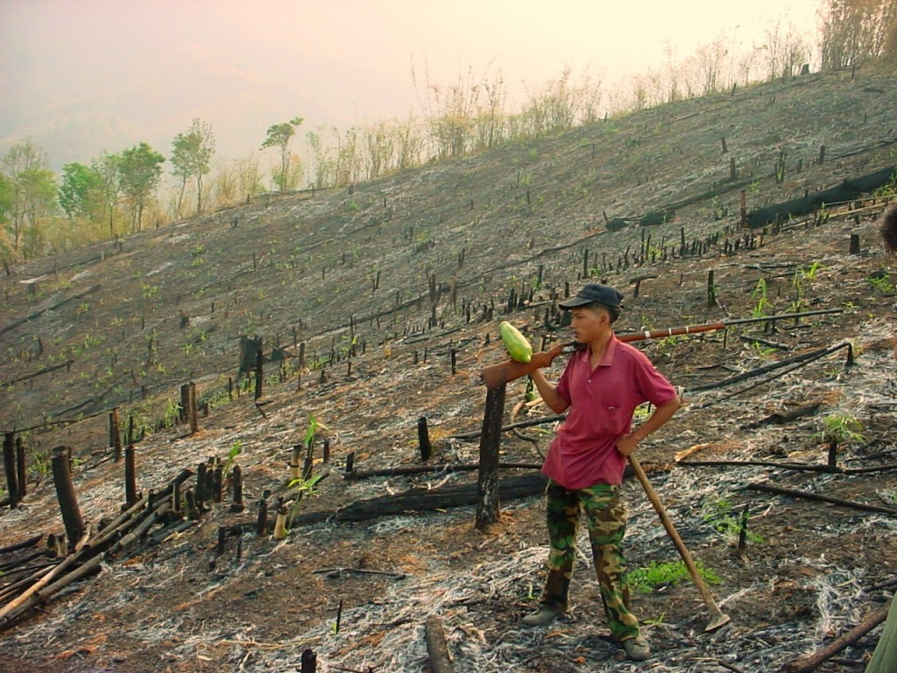
Shifting Cultivation
“Slash and Burn”
Interillage
Found in Tropical Zones
Involves farming large plots of land until nutrients are depleted and then moving on.

Slide 41
Shifting Cultivation: Found in tropical forests farmers aim to maintain soil fertility by rotating the fields they cultivate. The picture below is in the Amazon in Ecuador and an area is being cut down, ready for burning and then planting.

Slide 42
Mixing of seeds and seedlings in the same swidden is INTERTILLAGE.

Slide 43
Pastoralism
Herders follow their herds from pasture to pasture.
Africa, Middle East,
And Central Asia
Sheep, Goats, Camels, Cattle, Horses, Yaks

Slide 44
Transhumance: the movement of herds according to seasonal rhythms, warmer, lowland areas in the winter and cooler, highland areas in summer.

Slide 46
Commercial Agriculture
Notes:
Produces crops to sell in the marketplace, usually done in more developed countries and requires the use of machinery.
In the US it involves mass production of specialty crops that can be produced at a reduced price and sold at an increased cost.
Genetic engineering has led to increased production regardless of weather.

Slide 47
Mixed Crop and Livestock Farming
Usually near urban areas
Farmers grow crops and raise livestock on the same land
Most money comes from the sale of animal products.
Notes:
Most practice crop rotation where the field is divided into regions and each region grows a different seed and rotates over time.

Slide 48
This picture was taken near Lincoln, Nebraska as an example of MDC farming. What elements do you see?

Slide 49
Irrigation, haystacks, and corn fields as far as the eye can see. What you can’t imagine is the horrific smell. It was the smell of silage, a food grown to feed cattle, yet there were no cows in sight! Silage is green corn ground up mixed with molasses, put in silos or put in a rectangular hole in the ground which is called a silage pit. It is opened at the top and one end, when it rains, the water mixes with the silage and sometimes it runs out. A tarp is put over the pit and the heat from the sun causes the silage to ferment and rot. Farmers with more money use silos, farmers with less money dig pits.That is what you smell. Imagine the worst bathroom in a national park smell and then amplify it about 10 times.

Slide 50
BUT LOW AND BEHOLD, we drove up 100 yards and look what we found!! This is a feedlot: A large-scale production designed to pen up cattle to fatten for slaughter. (Hence the silage smell)

Slide 51
This is the same feedlot showing the facility. These are silos that the silage is stored in.

Slide 52
What happens here?
Cattle are kept in feedlots, raised on grain grown to feed them, and then slaughtered and sold to food companies. This is a large-scale production and just a snapshot of one company or family’s operation. Yes, there are small farms that grow cattle and crops for a much smaller-scale production, where the animals are treated more humanely.

Slide 53
Dairy Farming
Located in areas outside of urban locations.
Produce Milk, Butter Cheese
Labor Intensive and Expensive
Notes:
Most economically productive type of commercial agriculture.

Slide 54
A Milkshed is the ring of milk production that surrounds a major city.
Notes:
Growth in transportation technology has enabled dairy farmers to located farther from the city’s center, thus increasing the milkshed.
Technology has also led to increases in the amount of milk produced per cow.

Slide 55
Grain Farming
Production is largely mechanized
Labor is concentrated in planting and harvesting times.
Notes:
US is world’s largest large-scale grain producer. Ukraine was once considered the “bread basket” of Europe.
Many farms produce grain to be consumed by animals not humans.

Slide 56
Livestock Ranching
The commercial grazing of livestock over an extensive area.
Often practiced in arid or semi-arid regions
Notes:
Because meat and wool are in high demand, cattle and sheep are most common.
Practiced in US, Argentina, and Brazil – not really in Europe.
Many US farms are being converted into “fattening” farms on which fixed lot cattle are fattened before being slaughtered. Decline of ranching is partly due to low grain prices and by meat quality standards.

Slide 57
Different ways to determine the spatial distribution of cattle

Slide 58
Beef cows

Slide 59
Dairy farming

Slide 60
Plantation Farming
Large farms that specialize in one or two crops.
Called “Cash Crops” because they make money for their owners.
Cotton, Sugarcane, Tobacco, Coffee, Rubber
Notes:
Today most plantation exist in low-latitude regions of Africa, Asia, and Latin America but are owned by companies from more developed countries.

Slide 61
Mediterranean Agriculture
Agriculture located on Western coasts, with mild winters and dry summers.
Olives, Grapes, Fruits, Vegetables, wheat

Slide 62
Truck Farming
Commercial gardening and fruit farming. Mostly in SE.
Sell directly to consumers and companies who can or freeze the vegetable.

Slide 63
Plantation Farming
Large farms that specialize in one or two crops. Mostly in LDCs
Called “Cash Crops” because they make money for their owners.
Cotton, Sugarcane, Tobacco, Coffee, Rubber
Notes:
Today most plantation exist in low-latitude regions of Africa, Asia, and Latin America but are owned by companies from more developed countries.

Slide 64
What is a land-use model?

Slide 65
A Land Use Model shows the different ways that people use the land that is available to them.

Slide 66
What is Von Thunen’s Model?

Slide 67
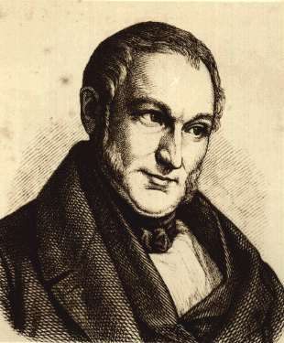
Von Thunen’s Model demonstrated the way that rural land use changed as a person moved outward from the center of a city area.

Slide 68
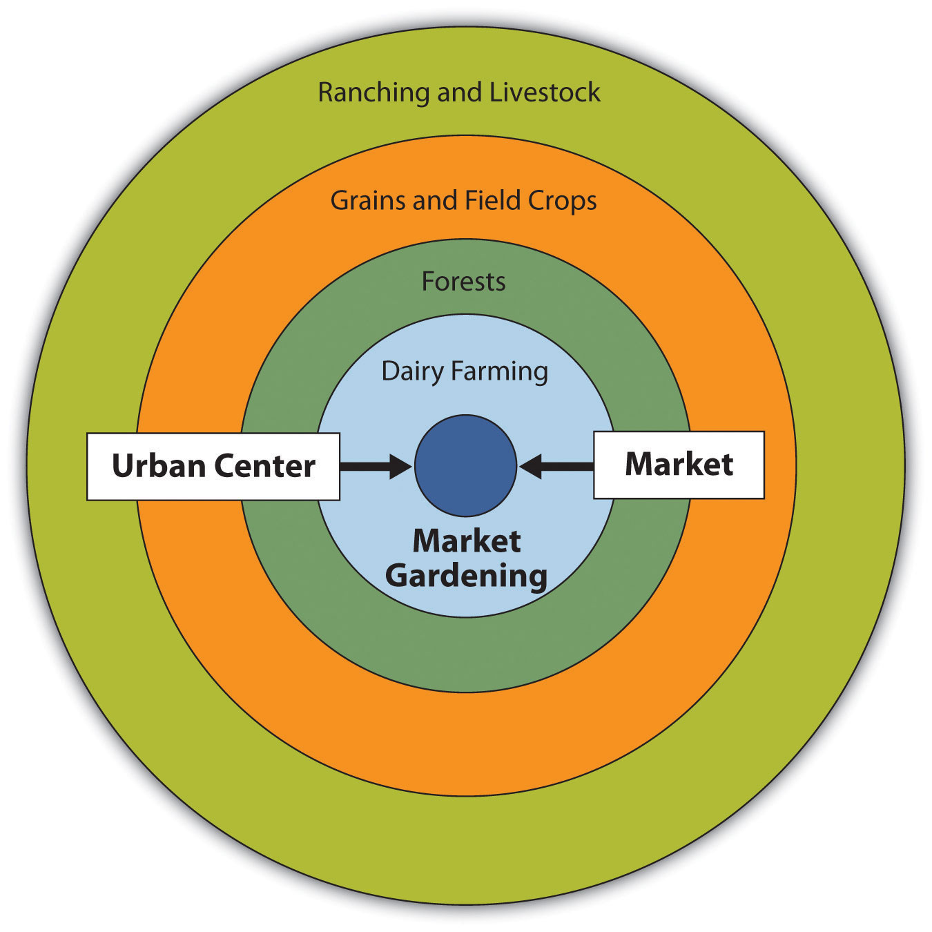
Notes:
Land closest to the city is more expensive

Slide 69
Market Gardening and Dairy
Forest
Field Crops
Nearest the town, farmers raised perishable products such as garden vegetables and milk.
Towns from Von Thunen’s Day were surrounded by a ring of trees used for construction.
Crops that are less perishable.
Animal Grazing
Required a lot of space.
Outside of these rings:
Transportation costs became to high for profitability.

Slide 70
Thunen’s Model Assumed
Flat Terrain
Uniform Soil
No significant barriers to transportation
Surrounded by unoccupied forest
Notes:
Useful when restricted to two variables – cost of land and transportation but there are other factors in the real world
Factors that help farmers make decisions:
Environmental – soil, relief, climate
Cultural – religion
Political – financial encouragement from the government
Economic – land rent

Slide 71
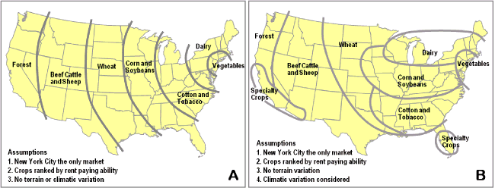
Notes:
Figure A represents what the agricultural land use would be if the most basic assumptions were applied, namely the market located at New York (or BostWash), crops being ranked by comparative rent paying abilities and considering ubiquitous geographical characteristics. Although this representation has some level of concordance with reality, it inaccurately portrays agricultural land use in the United States.
Figure B includes one supplementary assumption that considers climate variations, where the north is colder than the south. This constraint has a significant impact on agricultural land use as even if for a location a crop would have a higher rent paying ability, another crop would be grown because climatic conditions forbids it. The resulting agricultural land use has a much higher level of correspondence with reality.

Slide 72
Problems Faced by Farmers

Slide 73
Challenges for MDC Farmers
Problem
Solution
Overproduction- Due to the green revolution (pesticides, fertilizers) farmers can produce much more food than is needed
Farmers are encouraged to plant less
Gov. pays farmers when crop prices are low
Gov. buys surplus and sells it or donates it to foreign countries

Slide 74
Challenges for MDC Farmers
Problem
Solution
It is difficult to sustain the land
Sustainable Agriculture- Maintains and enhances the environment
Organic Farming
Fewer Pesticides and Chemicals
Protecting the soil from erosion through ridge tillage
Better integration of crops and livestock

Slide 75
Challenges for LDC Farmers
Problem
Solution
Population is growing rapidly
New farming methods with plows and manure (Not very effective)
Land is left fallow for shorter periods of time

Slide 76
Challenges for LDC Farmers
Problem
Solution
Technology is expensive and comes from MDCs
What are examples of this technology
Grow export crops to raise money
Coffee
Sugar
Cocaine!
Opium!

Slide 77
Decreasing food supply

Slide 78
What are we looking at???

Slide 79
How to Increase Food Supply?
Increase land by preventing desertification, which is caused by over cultivation and overgrazing

Slide 80
How to Increase Food Supply?
Increase productivity by spreading the Green Revolutions

Slide 81
How to Increase Food Supply?
Identify new food sources
Aquaculture-cultivate oceans

Slide 82
How to Increase Food Supply
Increase exports from other countries/ make foods seem better to eat
Ex. Soybeans and Bugs!!!

